Slide 1
Control Statements

Slide 2
Control Statements Include
Selection Statements
if
if-else
switch
Iteration Statements
for
while
do-while
Jump Statements
goto
break
continue
return

Slide 3
Learning objectives
Understanding meaning of a statement and statement block
Learn about decision type control constructs in C and the way these are used
Learn about looping type control constructs in C and the technique of putting them to use
Learn the use of special control constructs such as goto, break, continue, and return
Learn about nested loops and their utility

Slide 4
Program Control Statements/Constructs in ‘C’
Program Control Statements/Constructs
Selection/Branching
Conditional Type
Unconditional Type
Iteration/Looping
for
while
do-while
if
if-else
if-else-if
switch
break
continue
goto

Slide 5
OPERATORS
Operators
<
>
==
!
!=
||
<=
>=
&&
!=

Slide 6
Relational Operators
Equality and Logical Operators
To Specify | Symbol Used
less than | <
greater than | >
less than or equal to greater than or equal to | <= >=
To Specify | Symbol Used
Equal to | ==
Not equal to | !=
Logical AND | &&
Logical OR | ||
Negation | !

Slide 7
Points to Note
If an expression, involving the relational operator, is true, it is given a value of 1. If an expression is false, it is given a value of 0. Similarly, if a numeric expression is used as a test expression, any non-zero value (including negative) will be considered as true, while a zero value will be considered as false.
Space can be given between operand and operator (relational or logical) but space is not allowed between any compound operator like <=, >=, ==, !=. It is also compiler error to reverse them.
a == b and a = b are not similar, as == is a test for equality, a = b is an assignment operator. Therefore, the equality operator has to be used carefully.
The relational operators have lower precedence than all arithmetic operators.

Slide 8
A Few Examples
The following declarations and initializations are given:
int x=1, y=2, z=3;
Then,
The expression x>=y evaluates to 0 (false).
The expression x+y evaluates to 3 (true).
The expression x=y evaluates to 2 (true).

Slide 9
Logical operators may be mixed within relational expressions but one must abide by their precedence rules which is as follows:
(!)
NOT operator
&&
AND operator
||
OR operator

Slide 10
Operator Semantics
Operators | Associativity
() ++ (postfix) -- (postfix) | left to right
+ (unary) - (unary) | right to left
++ (prefix) -- (prefix) * / % | left to right
+ - | left to right
< <= > >= | left to right
== != | left to right
&& | left to right
|| | left to right
?: | right to left
= + = - = * = / = | right to left
, (comma operator) | left to right

Slide 11
Conditional Execution and Selection
Selection Statements
The Conditional Operator
The switch Statement

Slide 12
Selection Statements
One-way decisions using if statement
Two-way decisions using if-else statement
Multi-way decisions
Dangling else Problem

Slide 13
One-way decisions using if statement
Flowchart for if construct
if(TestExpr)
stmtT; T F
TestExpr
stmtT

Slide 14
Write a program that prints the largest among three numbers.
Algorithm | C Program
1. START | #include <stdio.h> int main() { int a, b, c, max; printf(“\nEnter 3 numbers”); scanf(“%d %d %d”, &a, &b, &c); max=a; if(b>max) { max=b; } if(c>max) { max=c; } printf(“Largest No is %d”, max); return 0; }
2. PRINT “ENTER THREE NUMBERS”
3. INPUT A, B, C
4. MAX=A
5. IF B>MAX THEN MAX=B
6. IF C>MAX THEN MAX=C
7. PRINT “LARGEST NUMBER IS”, MAX
8. STOP

Slide 15
Two-way decisions using if-else statement
Flowchart of if-else construct
The form of a two-way decision is as follows:
if(TestExpr)
stmtT;
else
stmtF;
TestExpr
stmtT
stmtF

Slide 16
Multi way Decisions
if(TestExpr1)
stmtT1;
else if(TestExpr2)
stmtT2;
else if(TestExpr3)
stmtT3;
.. .
else if(TestExprN)
stmtTN;
else
stmtF;
switch(expr)
{
case constant1: stmtList1;
break;
case constant2: stmtList2;
break;
case constant3: stmtList3;
break;
………………………….
………………………….
default: stmtListn;
}
if-else-if ladder
General format of switch statements

Slide 17
Flowchart of an if-else-if Construct
TestExpr
TestExpr2
TestExpr3
stmtT1
TestExprN
stmtT2
stmtT3
stmtTF
stmtTN

Slide 18
The following program checks whether a number given by the user is zero, positive, or negative
#include <stdio.h>
int main()
{
int x;
printf(“\n ENTER THE NUMBER:”);
scanf(“%d”, &x);
if(x > 0)
printf(“x is positive \n”);
else if(x == 0)
printf(“x is zero \n”);
else
printf(“x is negative \n”);
return 0;
}

Slide 19
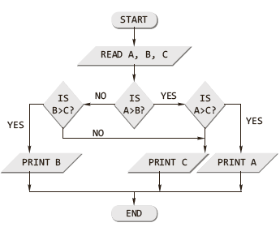
A program to find the largest among three numbers using the nested if
#include <stdio.h>
int main()
{
int a, b, c;
printf(“\nEnter the three numbers”);
scanf(“%d %d %d”, &a, &b, &c);
if(a > b)
{ if(a > c)
printf(“%d”, a);
else
printf(“%d”, c);
}
else
{ if(b > c)
printf(“%d”, b);
else
printf(“%d”, c);
}
return 0;
}

Slide 20
Nested if
Nested if
When any if statement is written under another if statement, this cluster is called a nested if.
The syntax for the nested is given here:
Construct 1 | Construct 2
if(TestExprA) if(TestExprB) stmtBT; else stmtBF; else stmtAF; | if(TestExprA) if(TestExprB) stmtBT; else stmtBF; else if(TestExprC) stmtCT; else stmtCF;

Slide 21
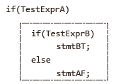
Dangling else Problem
This classic problem occurs when there is no matching else for each if. To avoid this problem, the simple C rule is that always pair an else to the most recent unpaired if in the current block. Consider the illustration shown here.
The else is automatically paired with the closest if. But, it may be needed to associate an else with the outer if also.

Slide 22
Solution to Dangling Else Problem
With null else | With braces
if(TestExprA) if(TestExprB) stmtBT; else ; else stmtAF; | if(TestExprA) { if(TestExprB) stmtBT; } else stmtAF;
Use of null else
Use of braces to enclose the true action of the second if

Slide 23
Find out an entered alphabet is vowel or consonant
If entered character is alphabet (small or capital range of alphabets)
If ch is vowel (a, e, i, o, u both in capital or small)
print vowel
else
print conso
else
enter valid alphabets

Slide 24
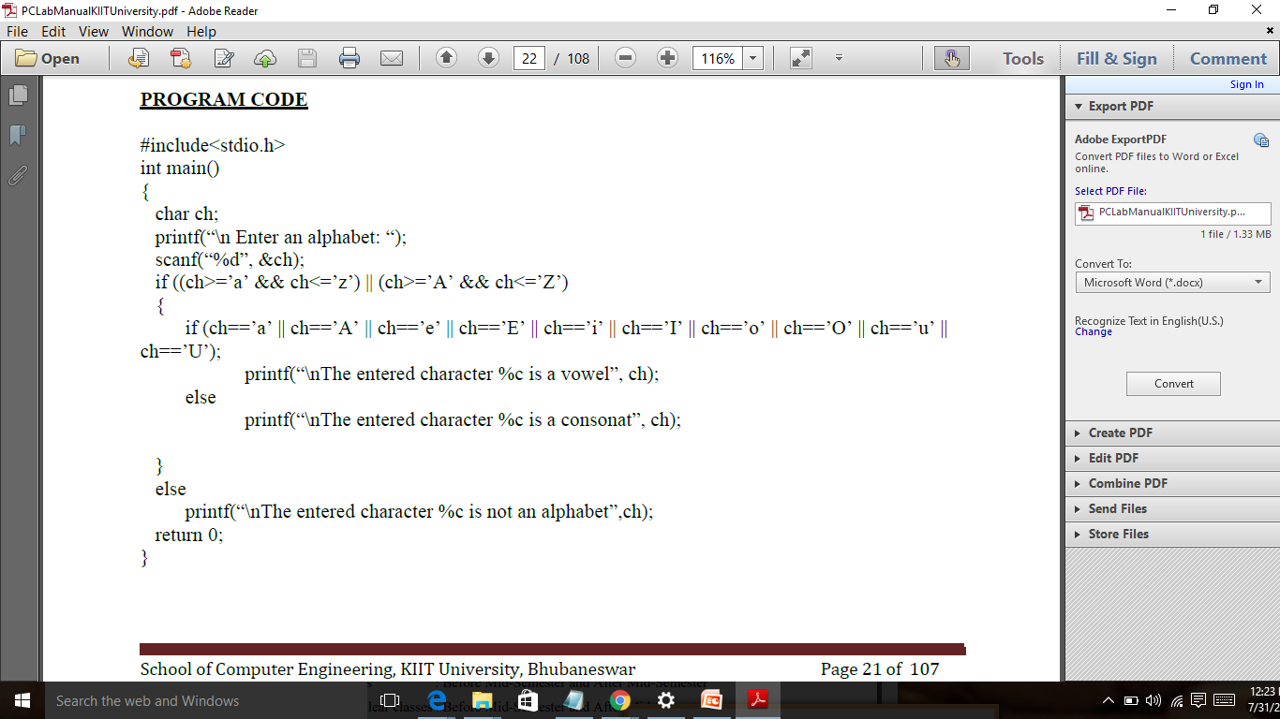

Slide 25
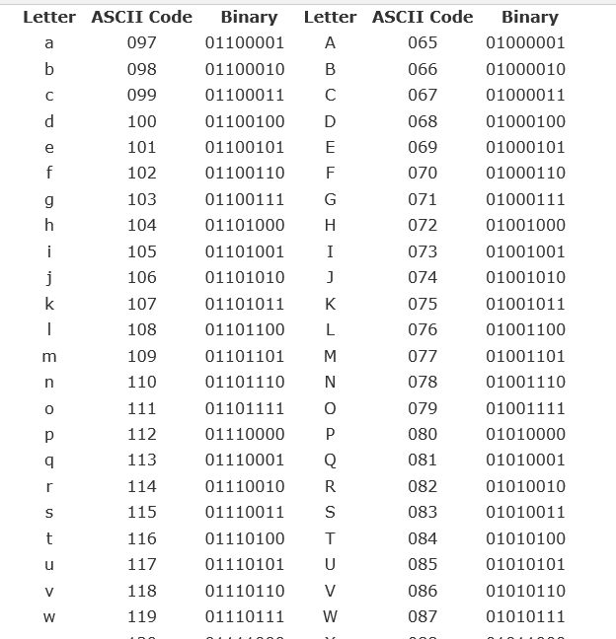

Slide 26


The Conditional Operator
It has the following simple format:
expr1 ? expr2 : expr3
It executes by first evaluating expr1, which is normally a relational expression, and then evaluates either expr2, if the first result was true, or expr3, if the first result was false.
#include <stdio.h>
int main()
{
int a,b,c;
printf(“\n ENTER THE TWO NUMBERS:”);
scanf(“%d %d”, &a, &b);
c=a>b? a : b>a ? b :-1;
if(c==-1)
printf(“\n BOTH NUMBERS ARE EQUAL”);
else
printf(“\n LARGER NUMBER IS %d”,c);
return 0;
}
An Example

Slide 27
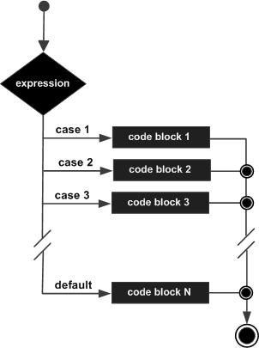
The Switch Statement
A switch statement allows a variable to be tested for equality against a list of values. Each value is called a case, and the variable being switched on is checked for each switch case

Slide 28
The Switch Statement
switch(expr)
{
case constant1: stmtList1;
break;
case constant2: stmtList2;
break;
case constant3: stmtList3;
break;
default: stmtListn;
}
The C switch construct

Slide 30
#include <stdio.h>
int main ()
{
char grade = 'B';
switch(grade)
{
case 'A' :
printf("Excellent!\n" );
break;
case 'B' :
break;
case 'C' :
printf("Well done\n" );
break;
case 'D' :
printf("You passed\n" );
break;
case 'F' :
printf("Better try again\n" );
break;
default : printf("Invalid grade\n" );
}
printf("Your grade is %c\n", grade );
return 0;
}

Slide 31
Switch Vs. Nested if
The switch differs from the else-if in that switch can test only for equality, whereas the if conditional expression can be of a test expression involving any type of relational operators and/or logical operators.
A switch statement is usually more efficient than nested ifs.
The switch statement can always be replaced with a series of else-if statements.

Slide 32
Iteration & Repetitive Execution
A loop allows one to execute a statement or block of statements repeatedly. There are mainly two types of iterations or loops – unbounded iteration or unbounded loop and bounded iteration or bounded loop.
A loop can either be a pre-test loop or be a post-test loop as illustrated in the diagram.

Slide 33
“While” Construct
Expanded Syntax of “while” and its Flowchart Representation
while statement is a pretest loop. The basic syntax of the while statement is shown below:

Slide 34
An Example
An Example
#include <stdio.h>
int main()
{
int c;
c=5; // Initialization
while(c>0)
{ // Test Expression
printf(“ \n %d”,c);
c=c-1; // Updating
}
return 0;
}
This loop contains all the parts of a while loop. When executed in a program, this loop will output
5
4
3
2
1

Slide 35
include<stdio.h>
int main()
{
int i=1;
while(i<=10)
{ printf("2 * %d = %d\n",i,2*i);
i++;
}
return 0;
}
C program to print the multiplication table of 2 from 1 to 10

Slide 36
/* calculate reverse number */
rev=0;
while (n!=0)
{
d= n%10;
rev=rev*10+d;
n/=10;
}

Slide 37
/* read any integer number print each digit into word */
/* use of switch statement */
#include<stdio.h>
#include<conio.h>
void main()
{
long int n,rev,n1;
int d;
clrscr();
printf("Enter any integer number ? ");
scanf("%ld",&n);
n1=n;
/* calculate reverse number */
rev=0;
while (n!=0)
{
d= n%10;
rev=rev*10+d;
n/=10;
}
printf("your number is (in figure) =%d\n",n1);
printf("your number is (in Word) = ");
while(rev!=0)
{ d=rev%10;
switch(d)
{
case 0:
printf("Zero ");
break;
case 1:
printf("One ");
break;
case 2:
printf("Two ");
break;
case 9:
printf("Nine ");
break;
}
rev=rev/10;
}

Slide 38
Testing for floating-point ‘equality’
float x;
x = 0.0;
while(x != 1.1)
{
x = x + 0.1;
printf(“1.1 minus %f equals %.20g\n”, x, 1.1 -x);
}
The above loop never terminates on many computers, because 0.1 cannot be accurately represented using binary numbers.
Never test floating point numbers for exact equality, especially in loops.
The correct way to make the test is to see if the two numbers are ‘approximately equal’.

Slide 39
“for” Construct
The general form of the for statement is as follows:
for(initialization; TestExpr; updating)
stmT;
for construct
flow chart

Slide 40
#include<stdio.h>
int main()
{
int i;
printf("\nThe natural number's are: ");
for(i=1;i<=10;i++)
printf("%d ",i);
return 0;
}

Slide 41
Example
#include <stdio.h>
int main()
{
int n, s=0, r;
printf(“\n Enter the Number”);
scanf(“%d”, &n);
for(;n>0;n/=10)
{
r=n%10;
s=s+r;
}
printf(“\n Sum of digits %d”, s);
return 0;
}
Program to find the sum of the digits for an entered number

Slide 42
#include <stdio.h>
int main()
{
int number, i;
printf("Enter a positive integer: "); scanf("%d",&number);
printf("Factors of %d are: ", number);
for(i=1; i <= number; ++i)
{ if (number%i == 0)
{ printf("%d ",i);
}
}
return 0;
}
Factors of a positive integer

Slide 43
Fibonacci Series
The Fibonacci sequence: 0, 1, 1, 2, 3, 5, 8, 13, 21
Program : Print Fibonacci Series up to n number of terms

Slide 44
#include <stdio.h>
int main()
{
int i, n, t1 = 0, t2 = 1, nextTerm;
printf("Enter the number of terms: ");
scanf("%d", &n);
printf("Fibonacci Series: ");
for (i = 1; i <= n; ++i)
{
printf("%d, ", t1);
nextTerm = t1 + t2;
t1 = t2;
t2 = nextTerm;
}
return 0;
}

Slide 45
“do-while” Construct
The C do-while loop
The form of this loop construct is as follows:
do
{
stmT; /* body of statements would be placed here*/
}while(TestExpr);

Slide 46
Point to Note
With a do-while statement, the body of the loop is executed first and the test expression is checked after the loop body is executed. Thus, the do-while statement always executes the loop body at least once.

Slide 47
Example - do loop
// Program to add numbers until user enters zero
#include <stdio.h>
int main()
{ double number, sum = 0;
// loop body is executed at least once
do
{ printf("Enter a number: ");
scanf("%lf", &number);
sum += number;
}
while(number != 0.0);
printf("Sum = %.2lf",sum);
return 0;
}
Output
Enter a number: 1.5
Enter a number: 2.4
Enter a number: -3.4
Enter a number: 4.2
Enter a number: 0
Sum = 4.70

Slide 48
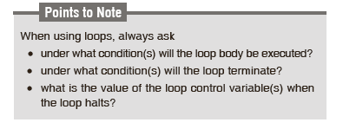
Which loop should be used???

Slide 49
When to use which loop
For, while loops are pre test loops. Do while is post test loop.
For loop is usually when the number of iterations are known in advance. Like o to 75 etc.
While and do while are for unknown iterations.
While – when you don’t even want to execute the body even once.
Do – while when you want to execute the body

Slide 50
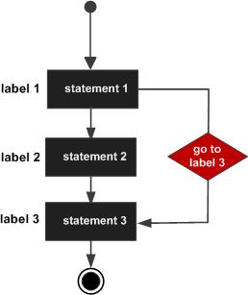
Go Statement
The control is unconditionally transferred to the statement associated with the label specified in the goto statement. The form of a goto statement is
syntax
goto label_name;
.. .
label_name: statement;

Slide 51
Go to example
#include <stdio.h>
int main ()
{ /* local variable definition */
int a = 10;
/* do loop execution */
LOOP:do
{
if( a == 15)
{ /* skip the iteration */
a = a + 1;
goto LOOP;
}
printf("value of a: %d\n", a);
a++; }
while( a < 20 );
return 0; }
Output
value of a: 10
value of a: 11
value of a: 12
value of a: 13
value of a: 14
value of a: 16
value of a: 17
value of a: 18
value of a: 19
Note that 15 is missing

Slide 52
SPECIAL CONTROL STATEMENTS
“break” statements
“continue” statements

Slide 53
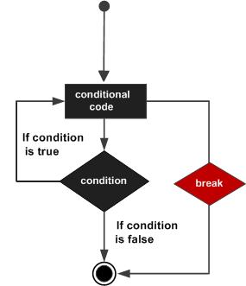
break
When a break statement is encountered inside a loop, the loop is immediately terminated and the program control resumes at the next statement following the loop.
It can be used to terminate a case in the switch statement (covered in the next chapter).

Slide 54
Example
#include <stdio.h>
int main ()
{ /* local variable definition */
int a = 10; /* while loop execution */
while( a < 20 )
{
printf("value of a: %d\n", a);
a++;
if( a > 15)
{ /* terminate the loop*/
break;
}
}
return 0; }
Output
Value of a: 10
value of a: 11
value of a: 12
value of a: 13
value of a: 14
value of a: 15

Slide 55
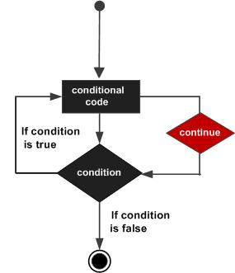
Continue
The continue statement in C programming works somewhat like the break statement. Instead of forcing termination, it forces the next iteration of the loop to take place, skipping any code in between.

Slide 56
example
#include <stdio.h>
int main ()
{
int a = 10;
/* do loop execution */
do
{ if( a == 15)
{ /* skip the iteration */
a = a + 1;
continue;
}
printf("value of a: %d\n", a);
a++;
} while( a < 20 );
return 0;
}
OUTPUT
value of a: 10
value of a: 11
value of a: 12
value of a: 13
value of a: 14
value of a: 16
value of a: 17
value of a: 18
value of a: 19
Note 15 is missing !

Slide 57
“break” & “continue” statements
break | continue
1. It helps to make an early exit from the block where it appears. | 1. It helps in avoiding the remaining statements in a current iteration of the loop and continuing with the next Iteration
2. It can be used in all control statements including switch construct. | 2. It can be used only in loop constructs.

Slide 58
Nested Loops
A nested loop refers to a loop that is contained within another loop.
If the following output has to be obtained on the screen
1
2 2
3 3 3
4 4 4 4
then the corresponding program will be
#include <stdio.h>
int main()
{
int row, col;
for(row=1;row<=4;++row)
{
for(col=1;col<=row;++col)
printf(“%d \t”, row);
printf(“\n”);
}
return 0;
}

Slide 59
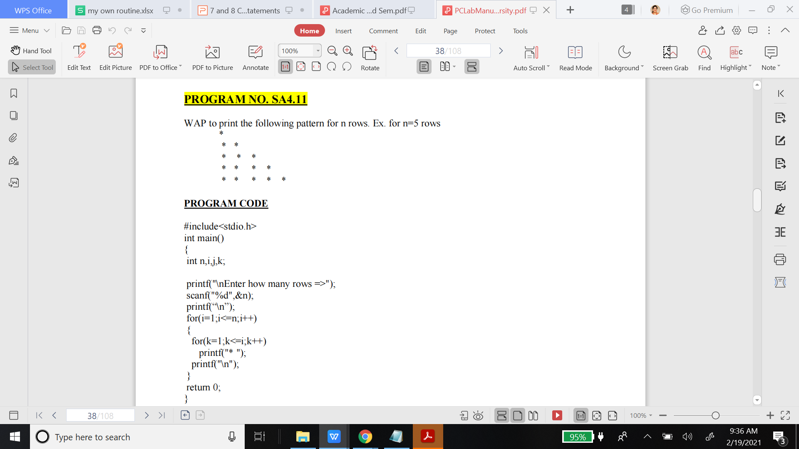

Slide 60
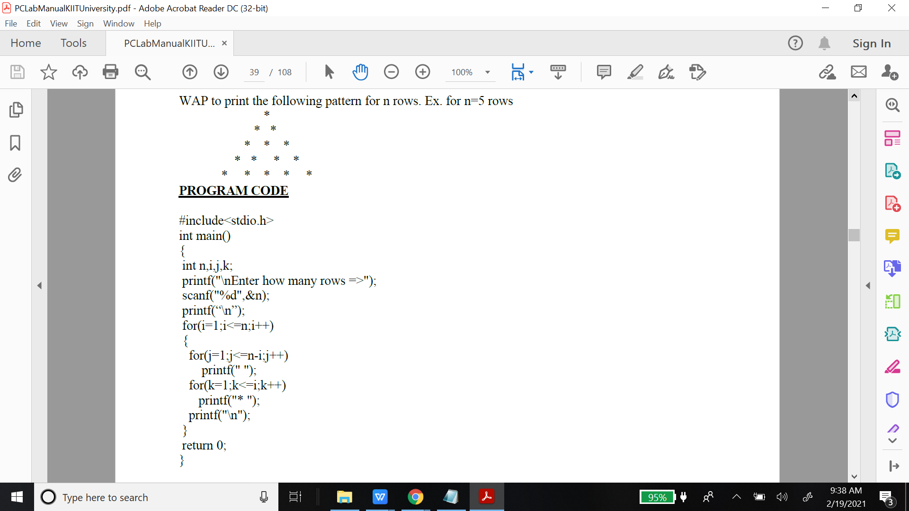

Slide 61
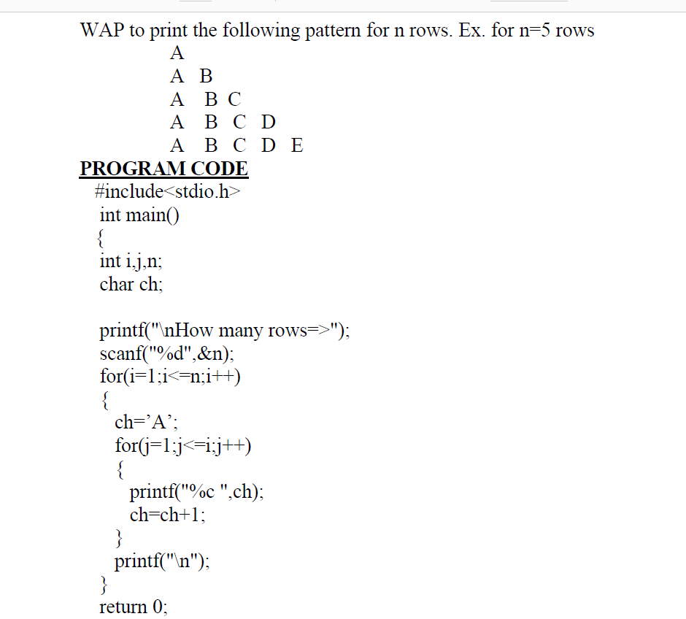

Slide 62
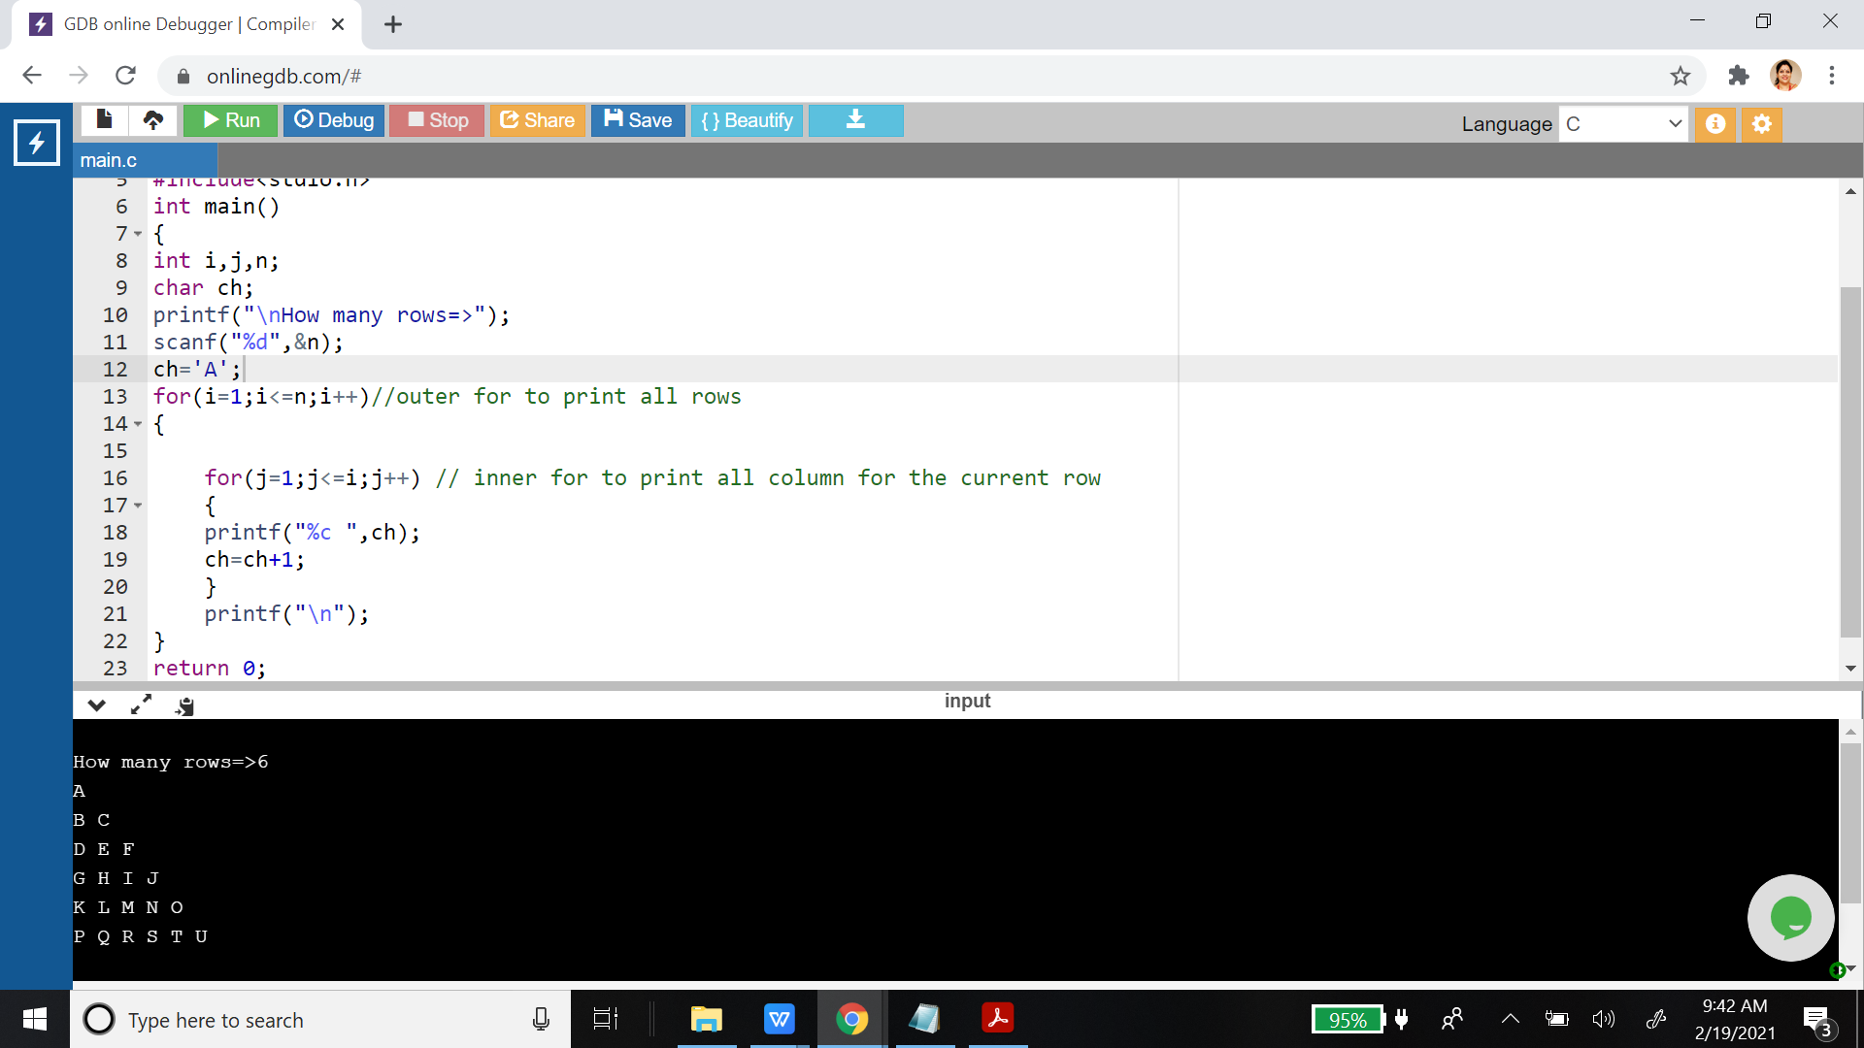

Slide 63
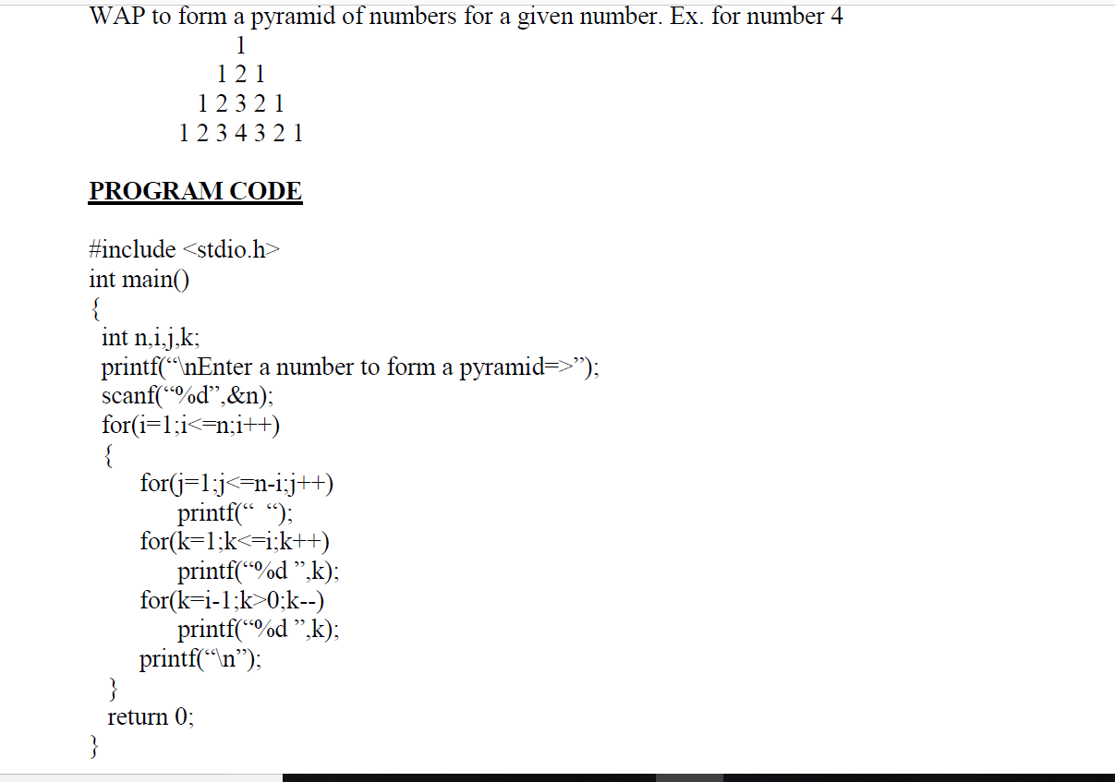

Slide 65
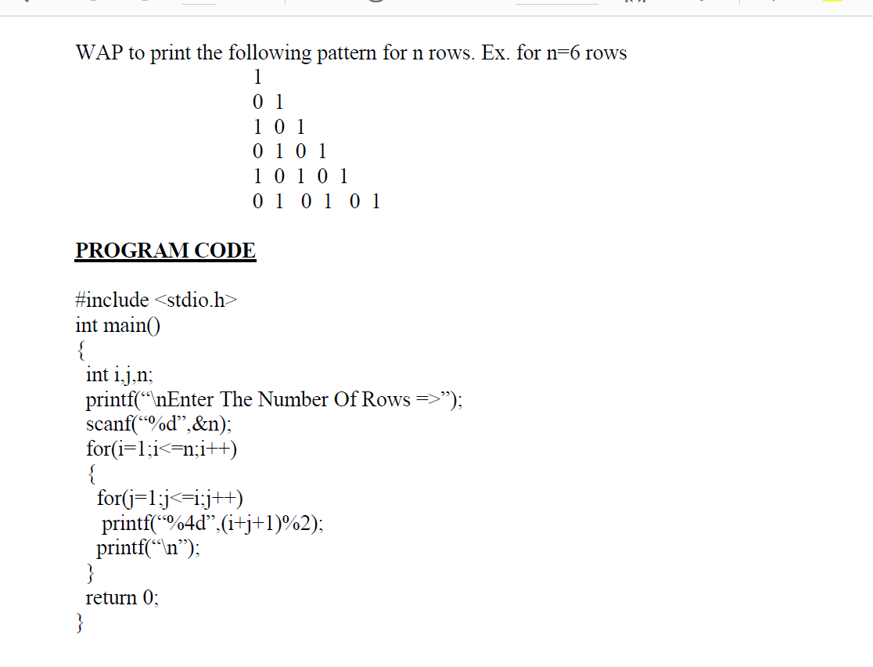

Slide 66
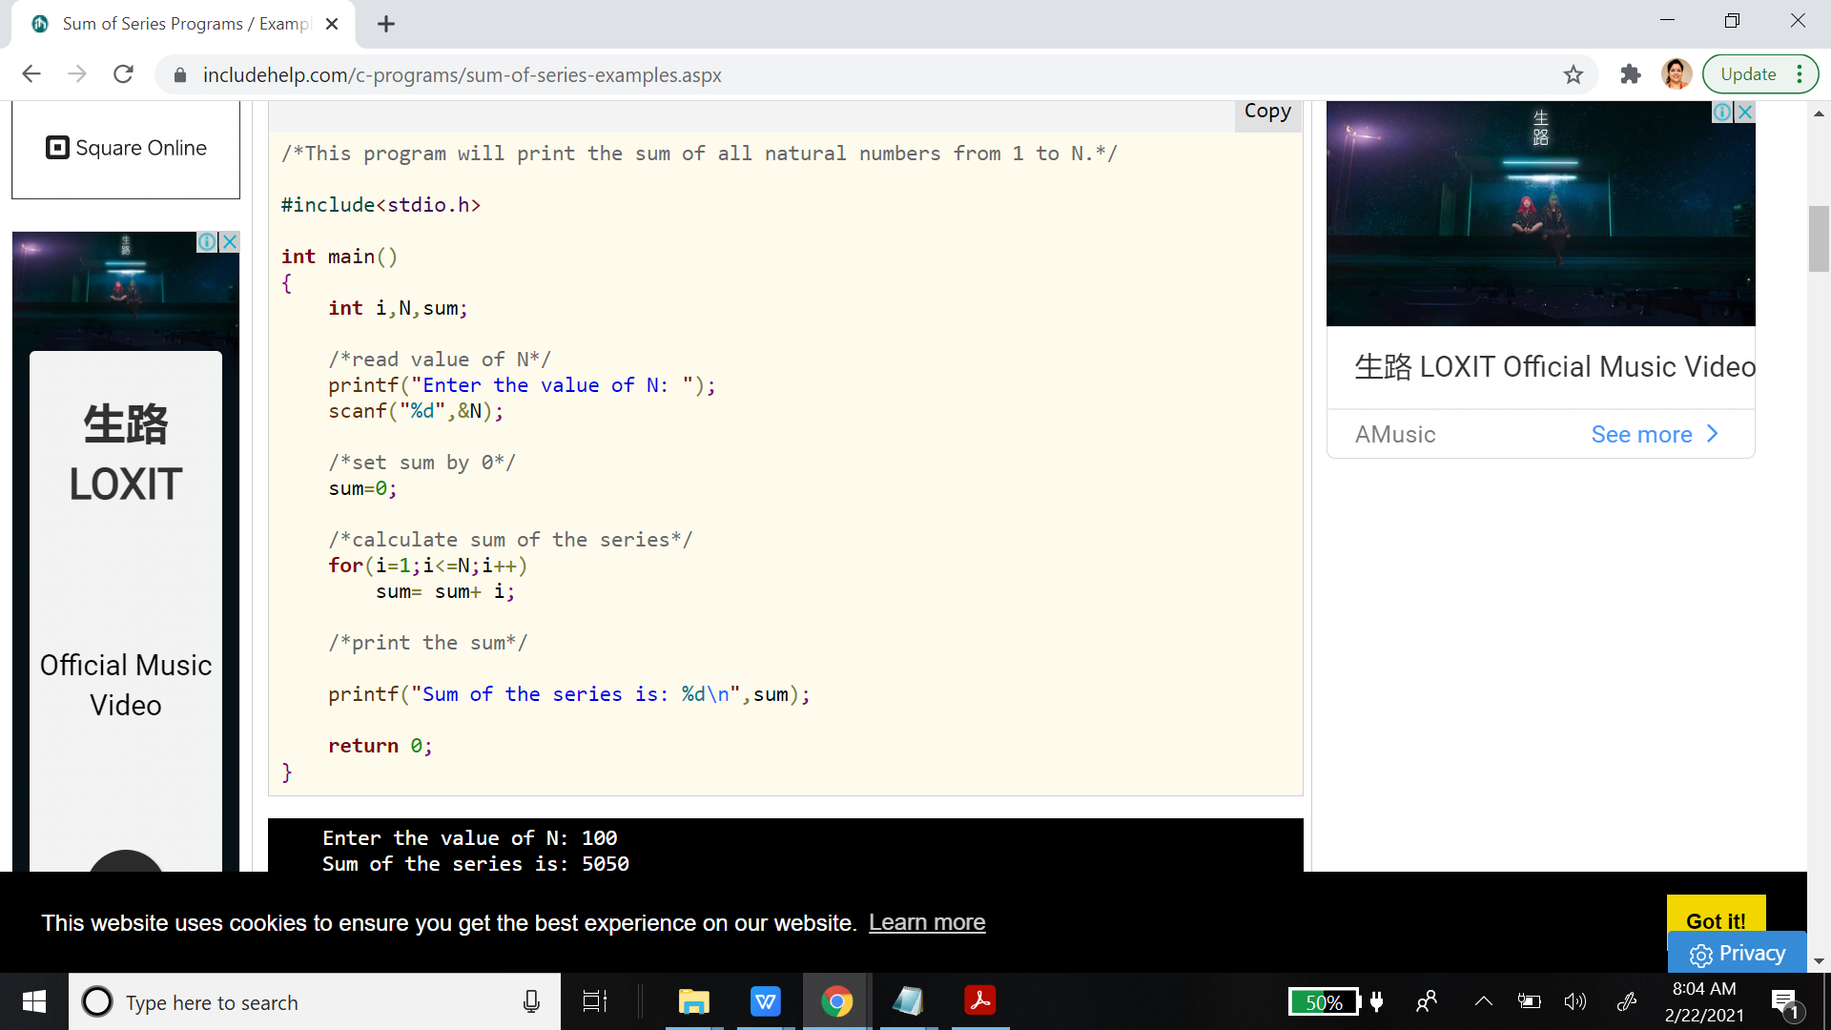
Series

Slide 67
Series: 1^2+2^2+3^2+4^2+..N^2

Slide 68
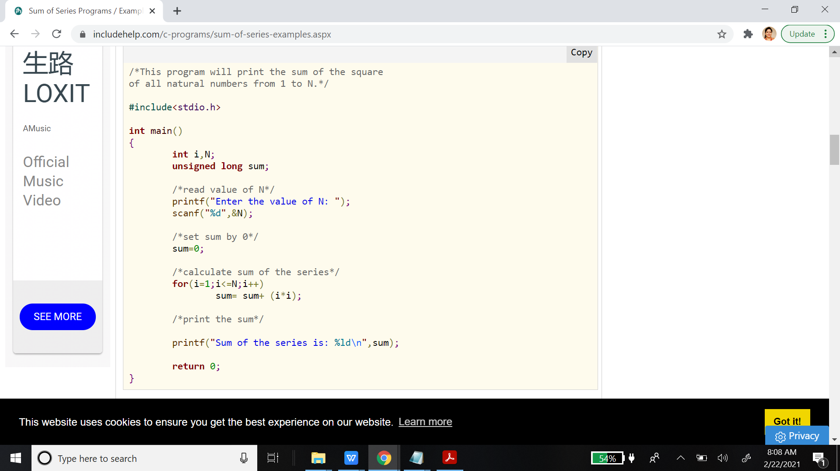
Series: 1^2+2^2+3^2+4^2+..N^2

Slide 69
Series 1+ 1/2 + 1/3 + 1/4 + 1/5 + .. 1/N

Slide 70
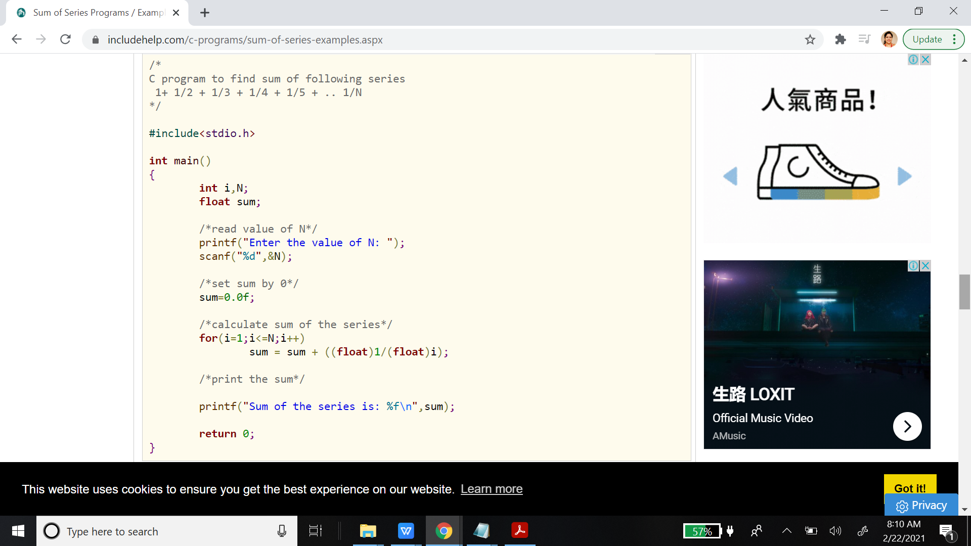
Series 1+ 1/2 + 1/3 + 1/4 + 1/5 + .. 1/N

Slide 71
Series 1 + 3^2/3^3 + 5^2/5^3 + 7^2/7^3 + ... till N terms

Slide 72
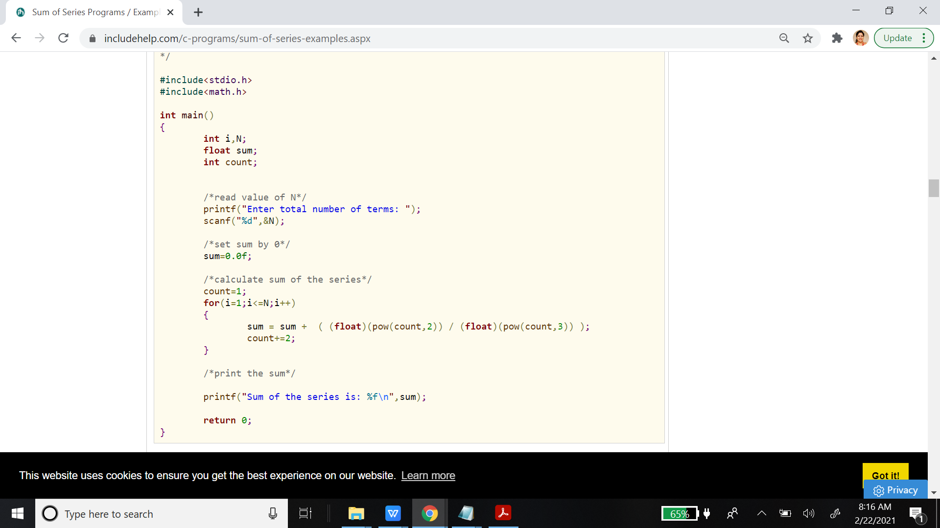
Series 1 + 3^2/3^3 + 5^2/5^3 + 7^2/7^3 + ... till N terms

Slide 73
Series S=1+(1+2)+(1+2+3)+...+(1+2+3+...+n)

Slide 74
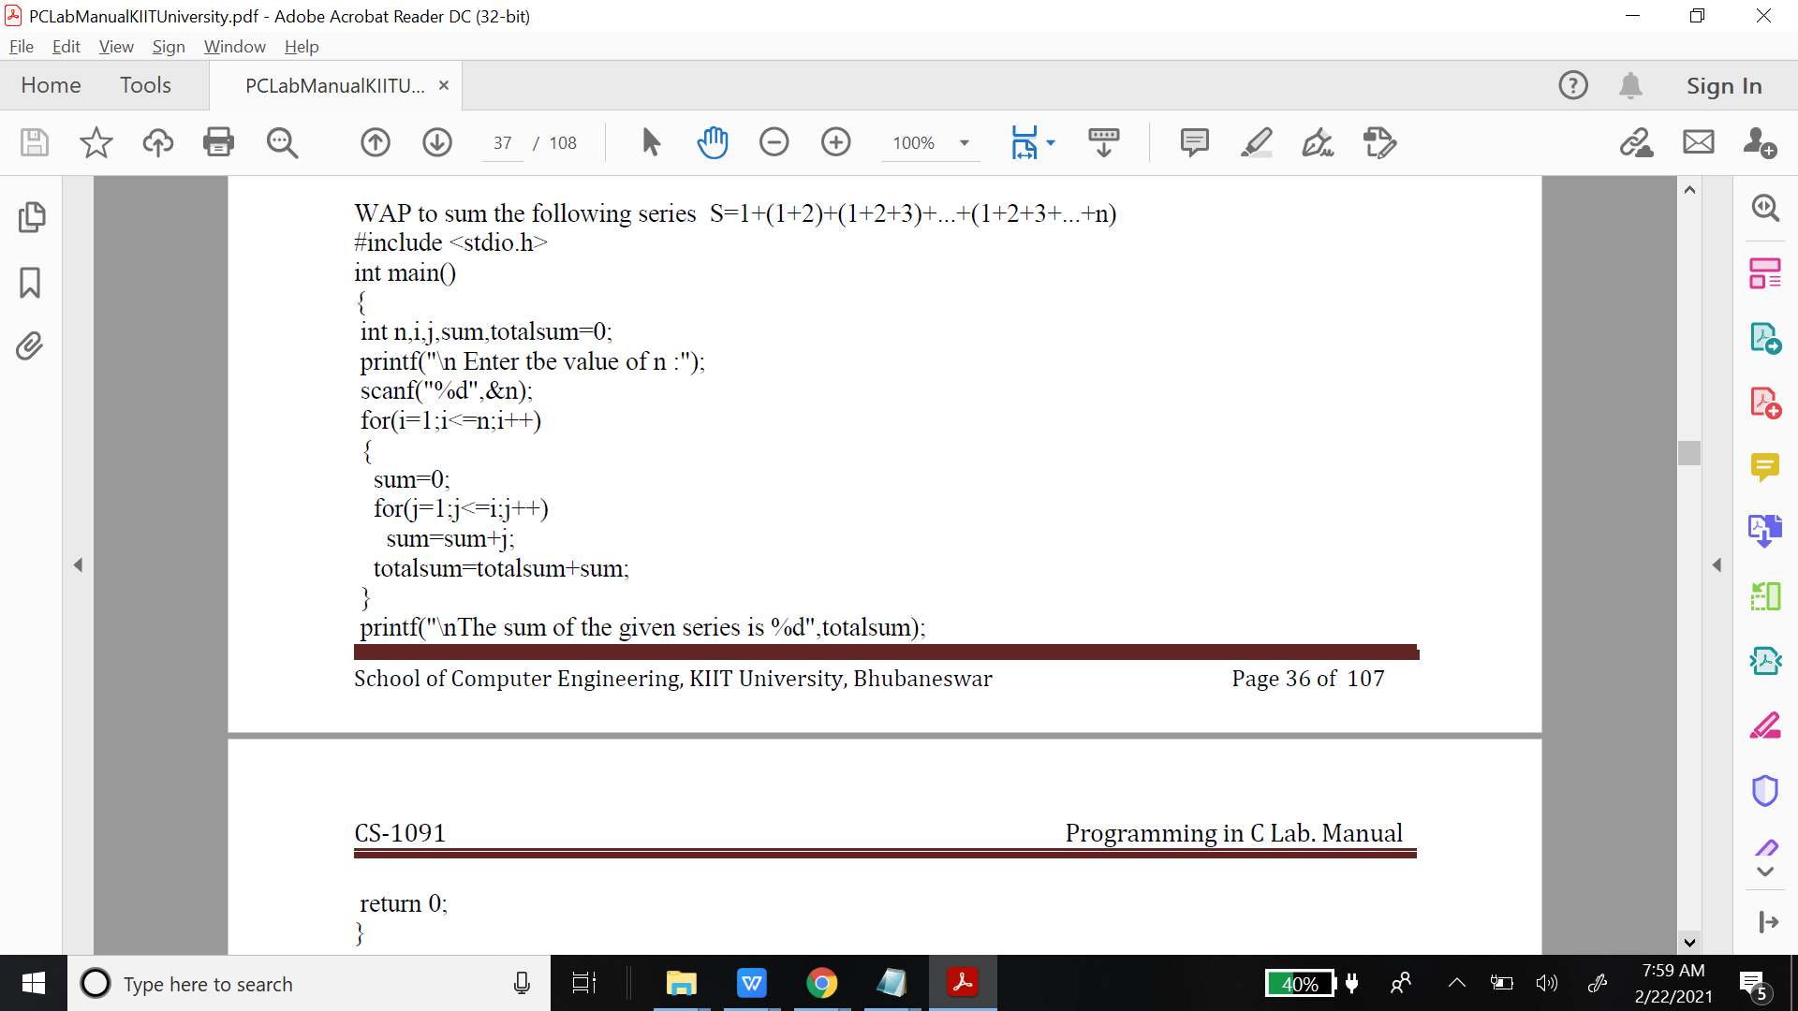
Series S=1+(1+2)+(1+2+3)+...+(1+2+3+...+n)

Slide 75
Common programming errors
Writing expressions like a<b<c or a==b==c etc.
Use of = instead of ==
Forgetting to use braces for compound statement
Dangling else
Use of semicolon in loop
Floating point equality

